Slide 2



Slide 3


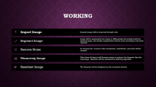
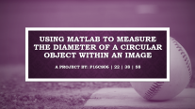
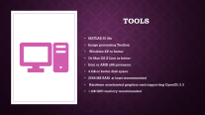
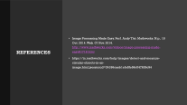
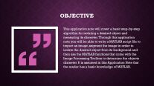
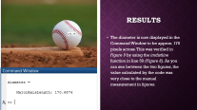
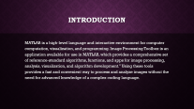
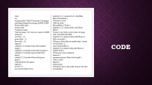
Using MATLAB to Measure the Diameter of a circular object within an image

Slide 4

Using MATLAB to Measure the Diameter of a circular object within an image
A Project by: F16CS06 | 22 | 38 | 58

Slide 5
Contents
Introduction
Objective
Working
Tools
Methodology
Code
Results
References

Slide 6
Introduction
MATLAB is a high-level language and interactive environment for computer computation, visualization, and programming. Image Processing Toolbox is an application available for use in MATLAB, which provides a comprehensive set of reference-standard algorithms, functions, and apps for image processing, analysis, visualization, and algorithm development.” Using these tools provides a fast and convenient way to process and analyze images without the need for advanced knowledge of a complex coding language.

Slide 7

Objective
This application note will cover a basic step-by-step algorithm for isolating a desired object and measuring its diameter. Through this application note you will be able to write a MATLAB script file to import an image, segment the image in order to isolate the desired object from its background and then use the MATLAB functions that come with the Image Processing Toolbox to determine the objects diameter. It is assumed in this Application Note that the reader has a basic knowledge of MATLAB.

Slide 8

Tools
MATLAB 2018a
Image processing Toolbox
Windows XP or better
Or Mac OS X Lion or better
Intel or AMD x86 processor
4 GB or better disk space
2048 MB RAM at least recommended
Hardware accelerated graphics card supporting OpenGL 3.3
1 GB GPU memory recommended

Slide 9
Working
Import Image
Desired image will be imported through code
Segment Image
Image will be segmented into image to differentiate the background from desired image, then further segmentation will be done according to the level of pixels
Remove Noise
To measure the accurate value of diameter, small blobs and noise will be cleaned
Measuring Image
After these all steps it will become easier to measure the diameter than the real image . diameter will be calculated by followng algorithm.
Resultant Image
The diameter will be displayed on the command window.

Slide 10
Working
Import Image
Segment Image
Remove Noise
Measuring Image
Resultant Image

Slide 11
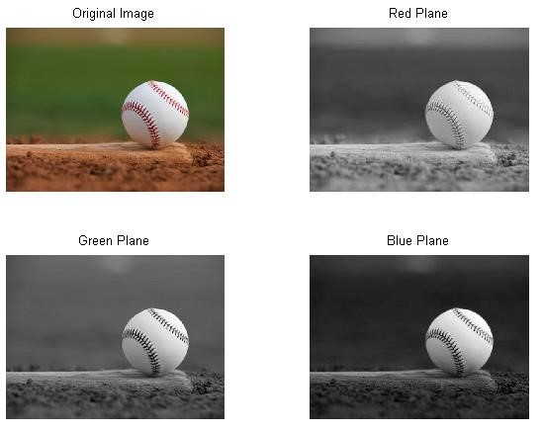
Methodology

Slide 12
Methodology

Slide 13
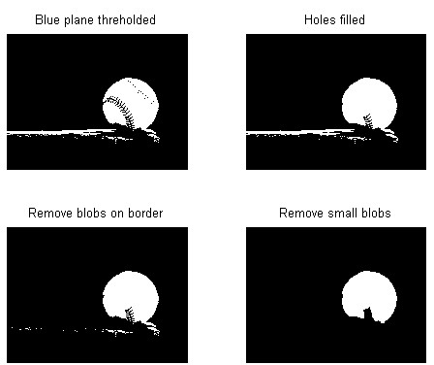
Methodology

Slide 14
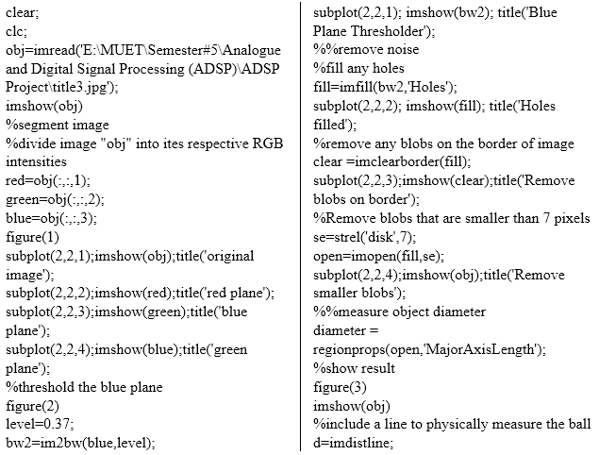
Code

Slide 15
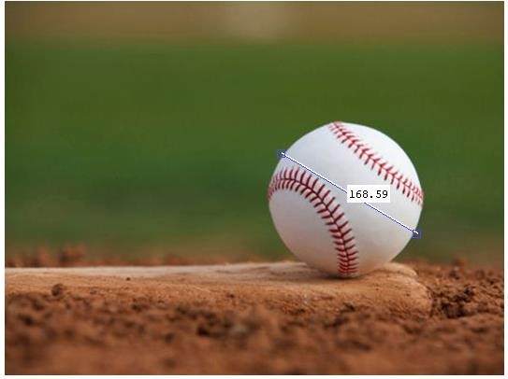
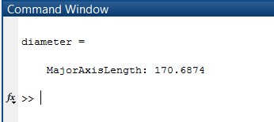
Results
The diameter is now displayed in the Command Window to be approx. 170 pixels across. This was verified in Figure 9 by using the imdistline function in line 50 (Figure 8). As you can see between the two figures, the value calculated by the code was very close to the manual measurement in figures.

Slide 16
References
Image Processing Made Easy. Perf. Andy Thé. Mathworks. N.p., 15 Oct. 2014. Web. 07 Nov. 2014. http://www.mathworks.com/videos/image-processing-made-easy81718.html
https://in.mathworks.com/help/images/detect-and-measure-circular-objects-in-an-image.html;jsessionid=24186caeb1efe5fe56c047626c94

Slide 17

Questions?

Slide 18
Thank You

